Slide 1

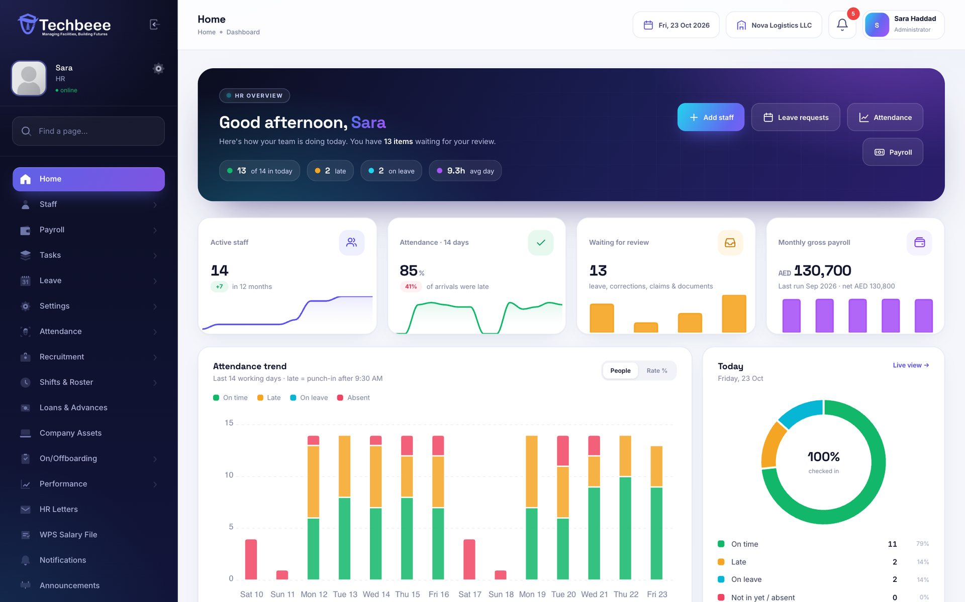
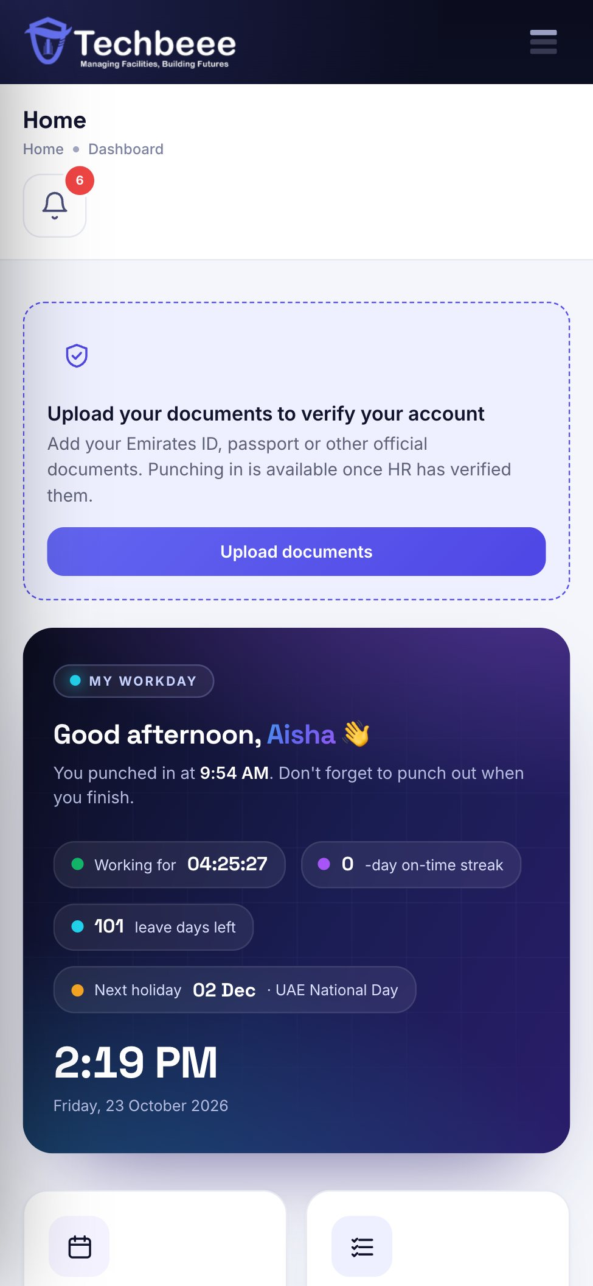
Techbeee HRMS
HR & payroll software for UAE companies
Attendance, leave, payroll, WPS, gratuity, documents and more — on the web and in every employee’s pocket.
30-day free trial
Web · iOS · Android
Built for the UAE
+971 56 388 6329 · support@techbeesoft.com · techbeesoft.com
Notes:
Techbeee HRMS is HR and payroll software built for companies in the UAE. One account works on the web, iPhone and Android. Every company can try all features free for 30 days.

Slide 2
















Everything HR, in one place
Dashboard & reports
Staff records
GPS attendance
Shifts & roster
Leave & holidays
Payroll & payslips
WPS salary file
Loans & advances
End of service
Documents & expiry
Insurance
Company assets
On/offboarding
Recruitment
Performance reviews
HR letters
Notes:
Sixteen modules in one system, all included in the free trial — no locked modules. Every module has a web screen for HR and, where it makes sense, self-service for employees in the app.

Slide 3

Built for UAE companies
WPS
Art. 51
30 days
3 apps
Salary file (SIF) for your bank or exchange house — straight from payroll
End-of-service gratuity under UAE Labour Law, calculated for you
Free trial with up to 10 staff and every feature switched on
Web dashboard plus iOS and Android apps for every employee
Currency of your choice
AED, SAR, QAR, KWD, USD and more — on salaries, payslips and letters
Emirates ID, visa & passport
Expiry dates tracked with reminders to HR and the employee
Office-network punch-in
Limit punch-in to up to 3 office IPs; GPS location saved on every punch
Each company sees only its own data
Roles and permissions for team leads and HR assistants
Notes:
What makes it a good fit for the UAE: WPS file, gratuity under Article 51 of the Labour Law, document expiry for Emirates ID and visas, and a 30-day free trial.

Slide 4
Your whole company at a glance
DASHBOARD
Who is in, who is late or on leave, what waits for approval and what payroll costs — the moment you sign in.
Live attendance today and a 14-day trend
Requests waiting: leave, corrections, claims, documents
Payroll cost, headcount, departments and nationalities
Recent activity and company announcements
Notes:
The dashboard opens with today's attendance and the items waiting for HR. Every card links straight to its list.

Slide 5
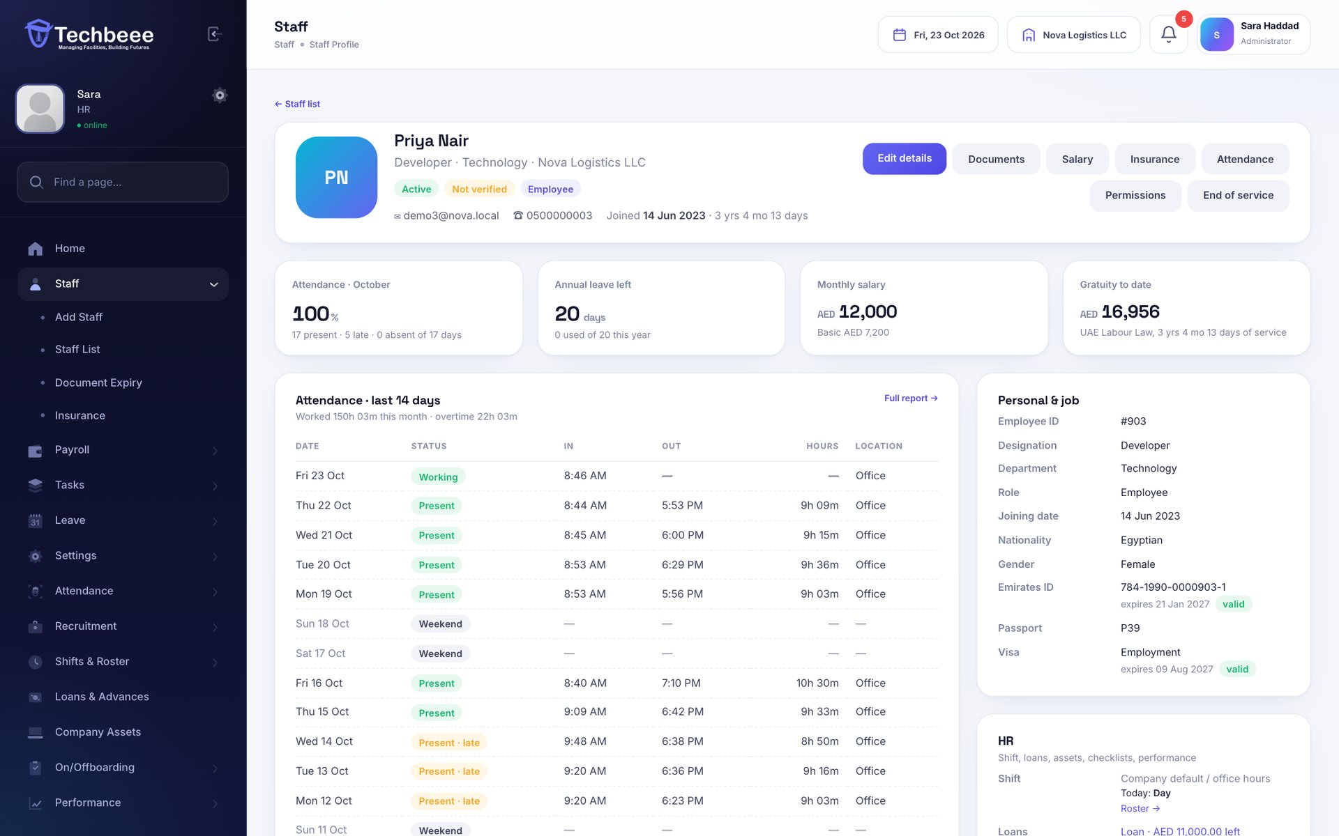
Every employee file in one place
STAFF PROFILE
Click any name to see the full picture: job, pay, attendance, leave, documents, insurance, loans and assets.
Emirates ID, passport and visa with expiry badges
Salary breakdown and approved bank account
Attendance, leave balances, payslips and tasks
History of every change to the record
Notes:
The staff profile brings everything about one employee onto one page, with buttons to edit details, documents, salary, insurance, permissions and end of service.

Slide 6
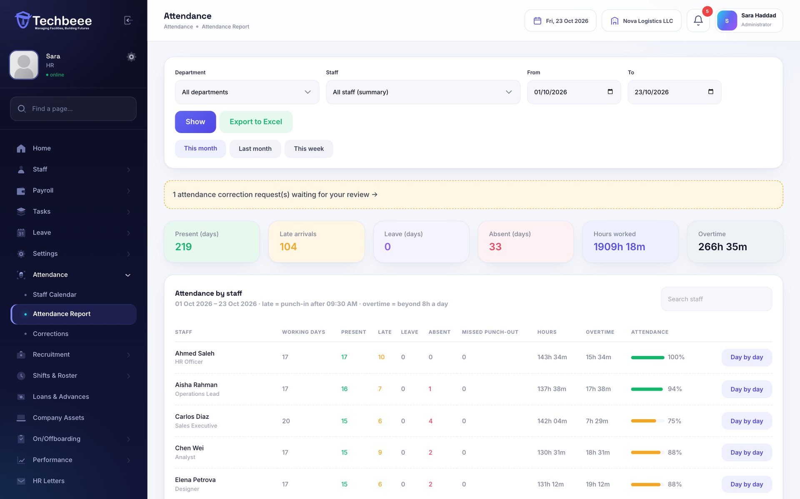
Attendance with GPS punch-in
ATTENDANCE
Staff punch in and out from the app or the web. Each punch saves the time and the street address.
Late, early-out, overtime and absences worked out
Reports per person and department, day by day
Correction requests for missed punches
Office-network rule: punch in only on office Wi-Fi
Notes:
Attendance is calculated against each person's working hours or shift. Admins can restrict punch-in to the office network.

Slide 7
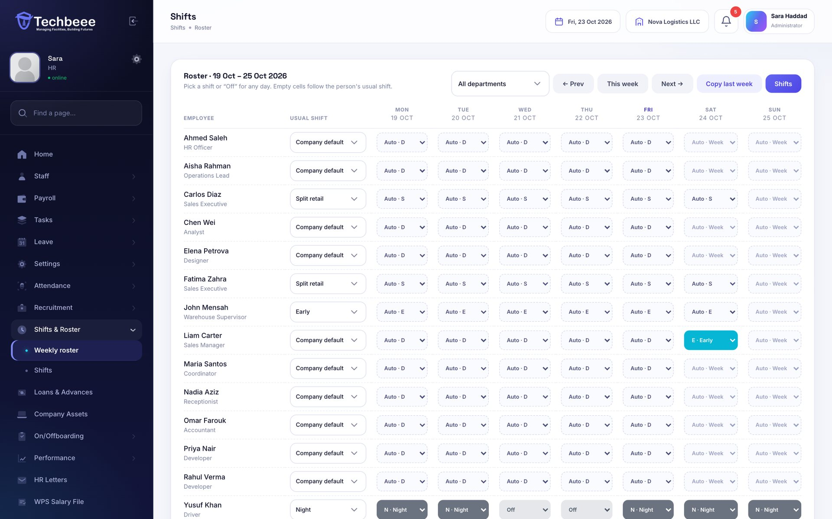
Shifts and weekly rosters
SHIFTS & ROSTER
Day, night and split shifts with their own grace time and break — planned on a weekly roster grid.
Night shifts that run past midnight
Pick a shift or “Off” for any day; copy last week
Lateness and overtime follow each person’s shift
Staff see their next two weeks in the app
Notes:
Companies without shifts keep using office hours from Company Settings. With shifts, attendance, reports and payroll follow the roster.

Slide 8
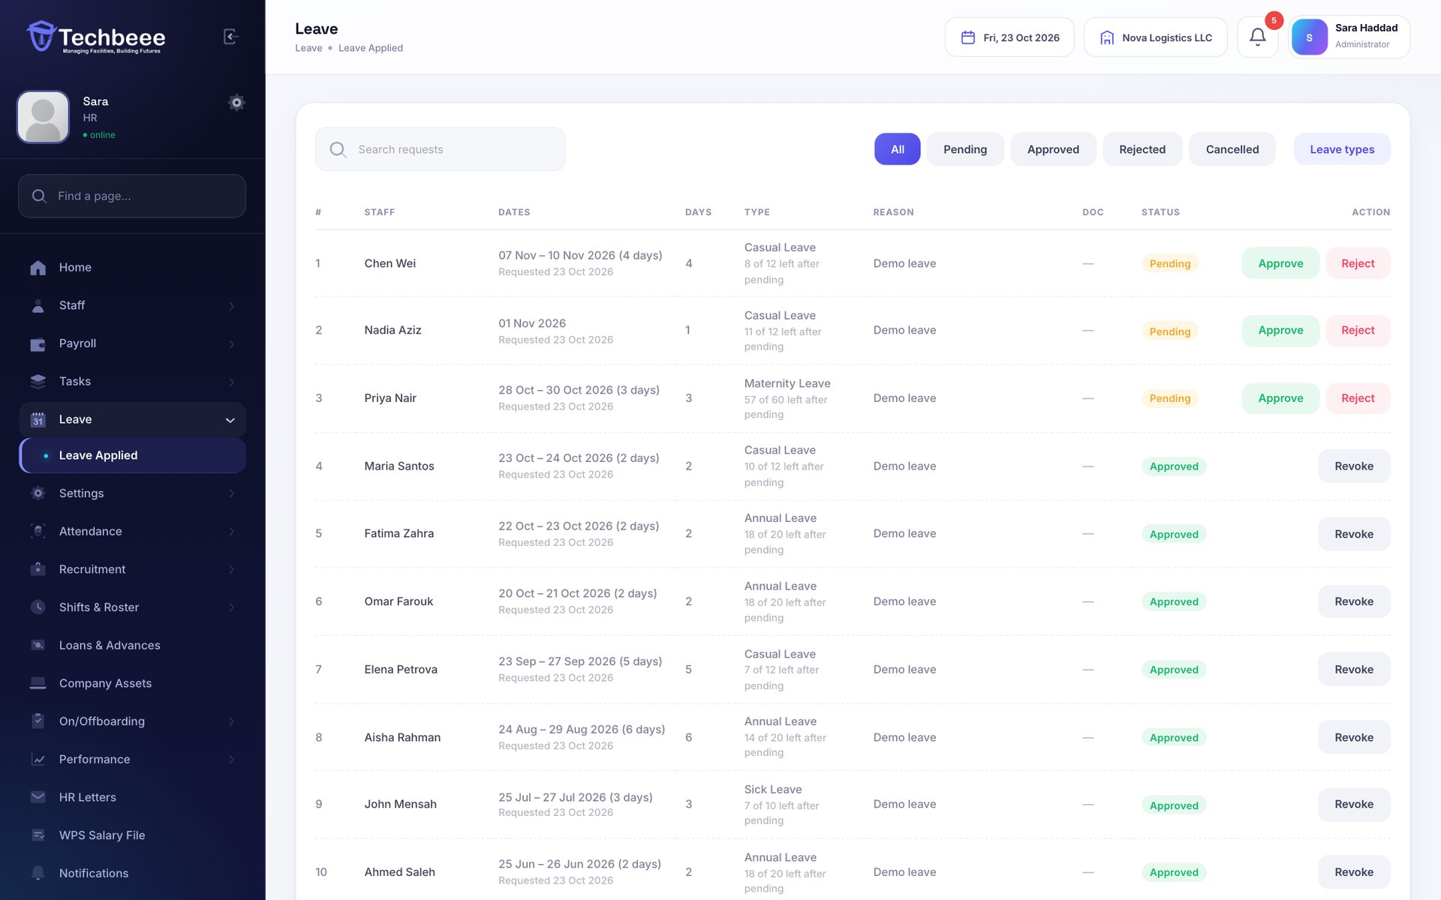
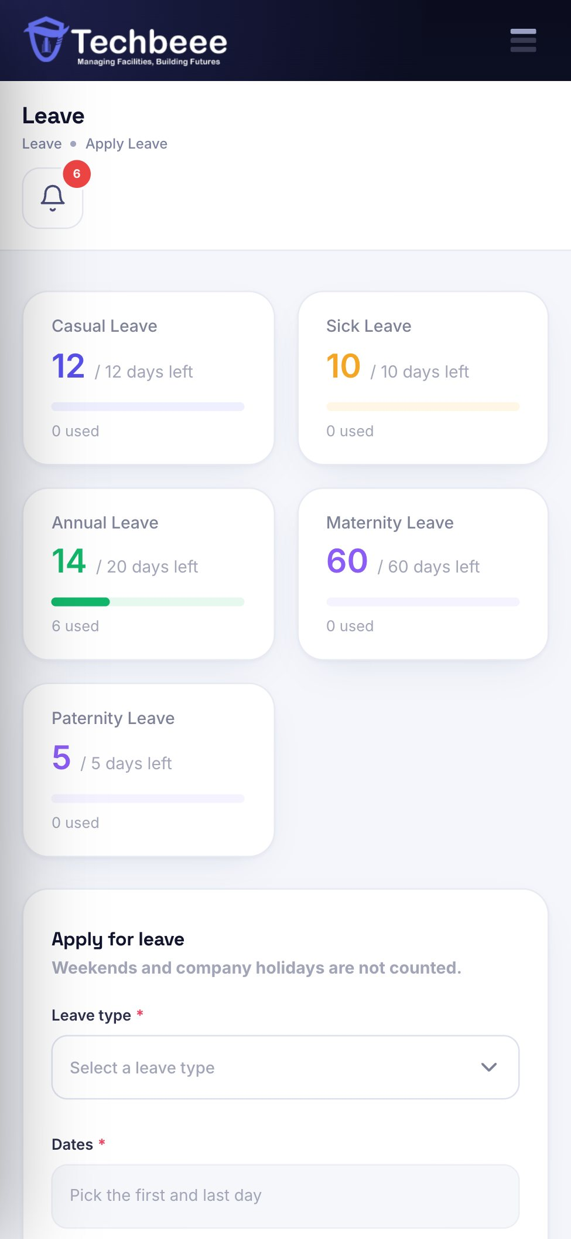
Leave with balances and approvals
LEAVE & HOLIDAYS
Employees see their balance before they apply. Weekends and public holidays are skipped automatically.
Annual, sick, maternity, unpaid and custom types
Half days and required attachments (e.g. sick note)
Approve or reject with a note — staff are notified
Unpaid leave is deducted in payroll
Notes:
Team leads can approve leave for their department when given that permission.

Slide 9
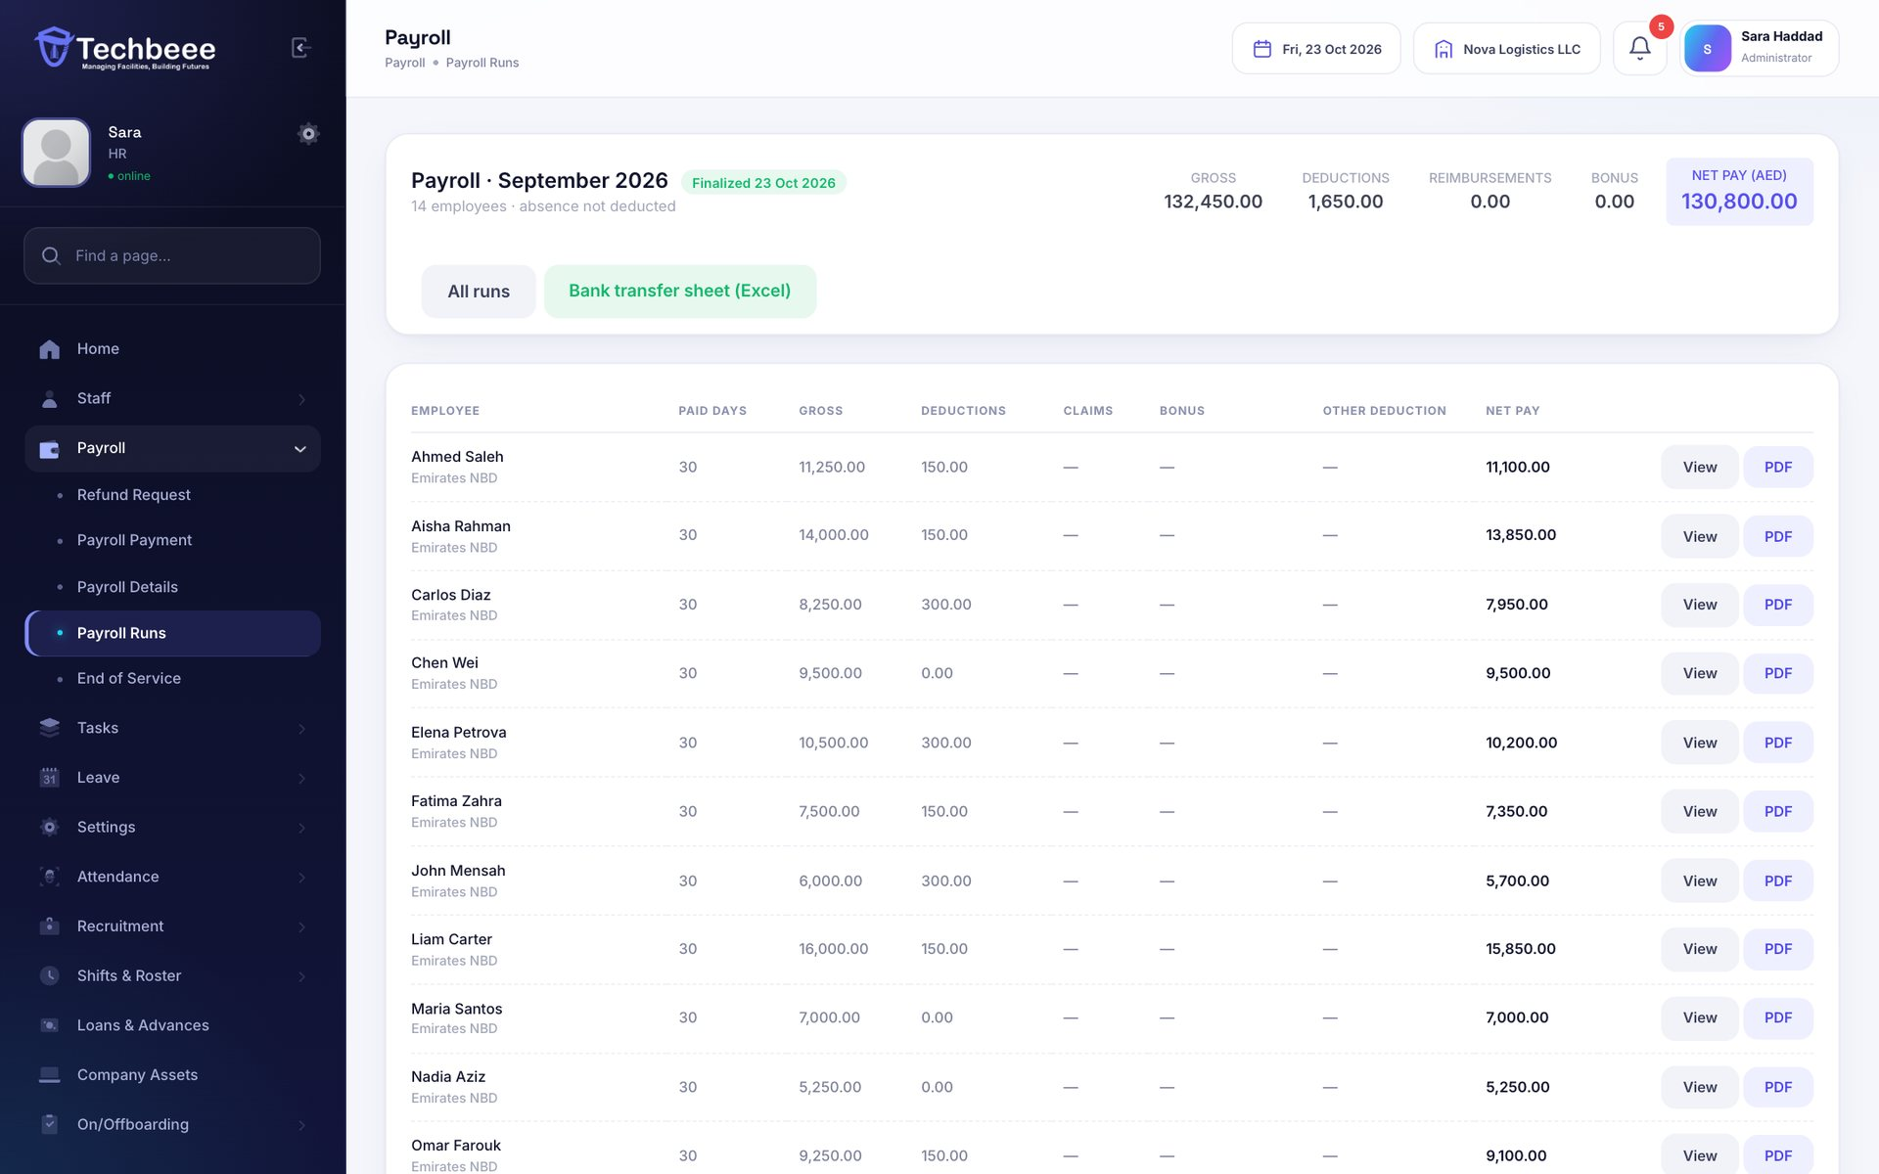
Payroll in minutes, PDF payslips for all
PAYROLL
Build the month from each salary structure; joiners, unpaid leave, claims and loan instalments are worked out.
Basic, housing, transport and other allowances
Bonuses and one-off deductions while it is a draft
Finalise to send every employee a PDF payslip
Bank transfer sheet in Excel
Notes:
Payroll runs are drafts until HR finalises them. Finalising sends payslips and records loan repayments.

Slide 10
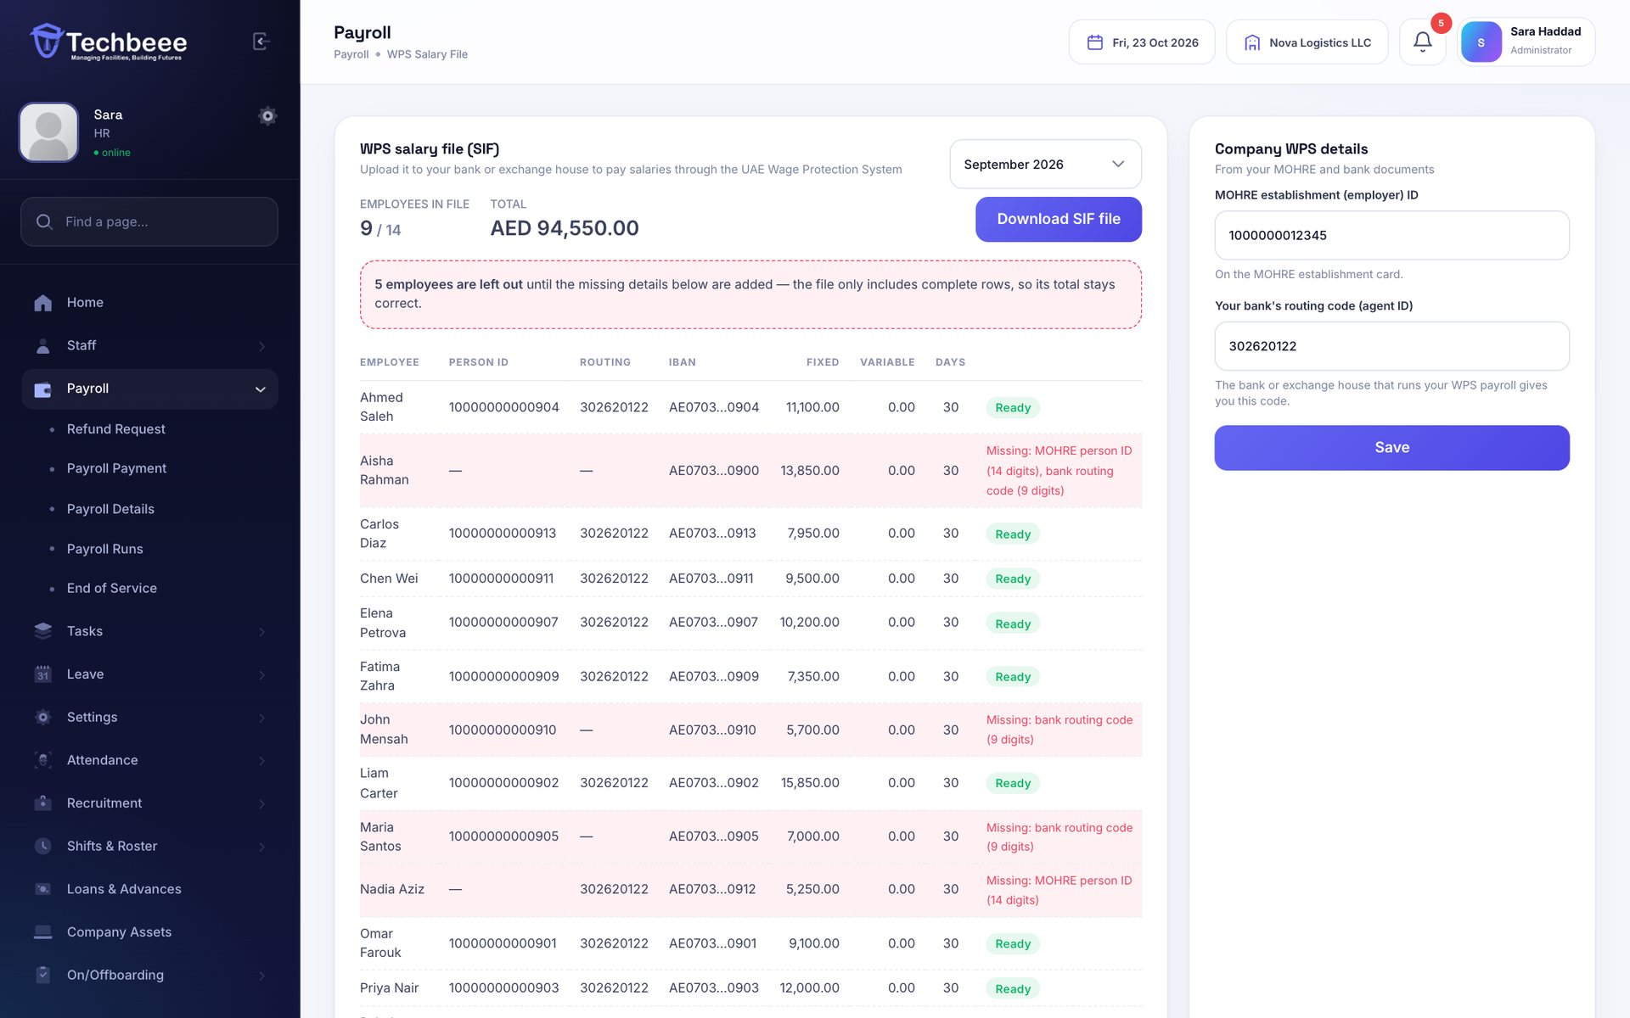
WPS salary file, ready for your bank
WPS / SIF
Pick a finalised month and download the Central Bank SIF file for your bank or exchange house.
EDR line per employee and the SCR control line
Checks MOHRE person ID, routing code and IBAN
Rows with missing details are left out, totals match
Company MOHRE ID and bank code stored once
Notes:
The page lists anything missing before the file is made, so the bank won't reject it.

Slide 11
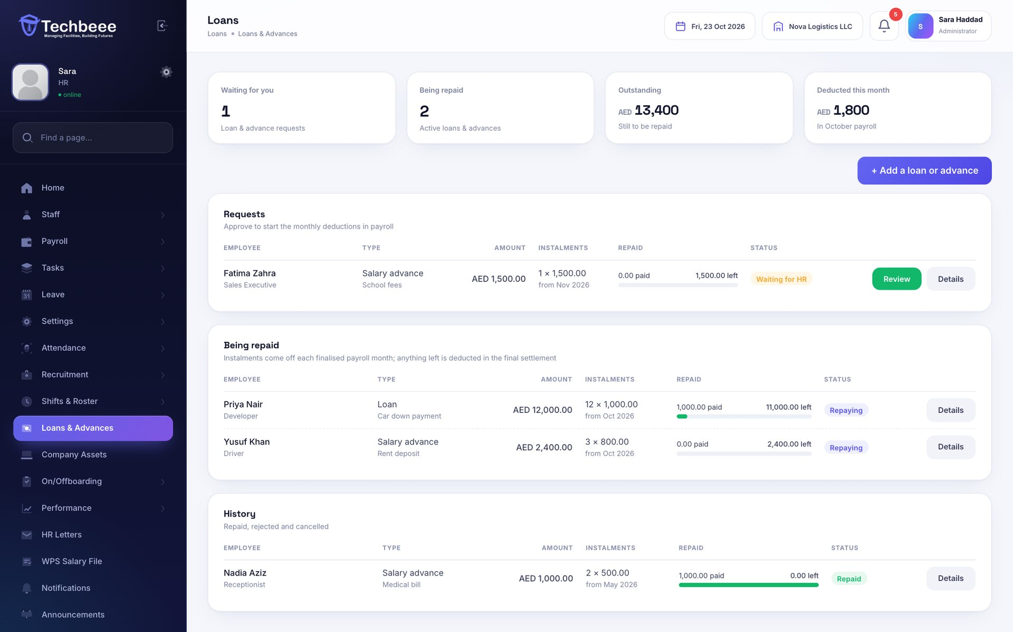
Loans and salary advances
LOANS & ADVANCES
Staff ask for an advance or a loan; HR approves the amount and instalments and payroll does the rest.
Monthly instalment taken in payroll automatically
Repayment progress and balance for every loan
Cash repayments recorded by HR
Remaining balance deducted in the final settlement
Notes:
Approved loans start deducting from the chosen month. Whatever is left when someone leaves is deducted in their end-of-service settlement.

Slide 12
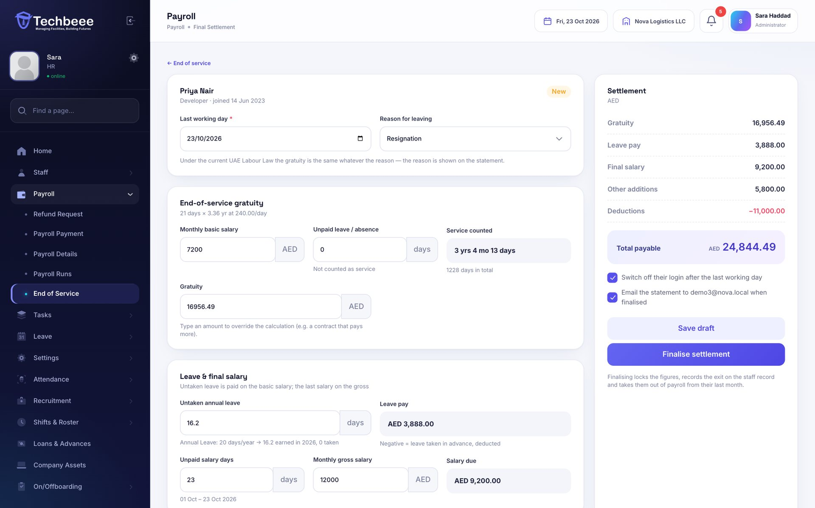
Gratuity and final settlement
END OF SERVICE
When someone leaves, the settlement is calculated under UAE Labour Law and a PDF statement is ready to sign.
21 days’ basic per year for 5 years, 30 days after
Untaken leave, last salary, notice pay, air ticket
Gratuity owed today for every employee
Login switched off after the last working day
Notes:
HR can override any figure. Finalising records the exit, opens the offboarding checklist and settles open loans.

Slide 13
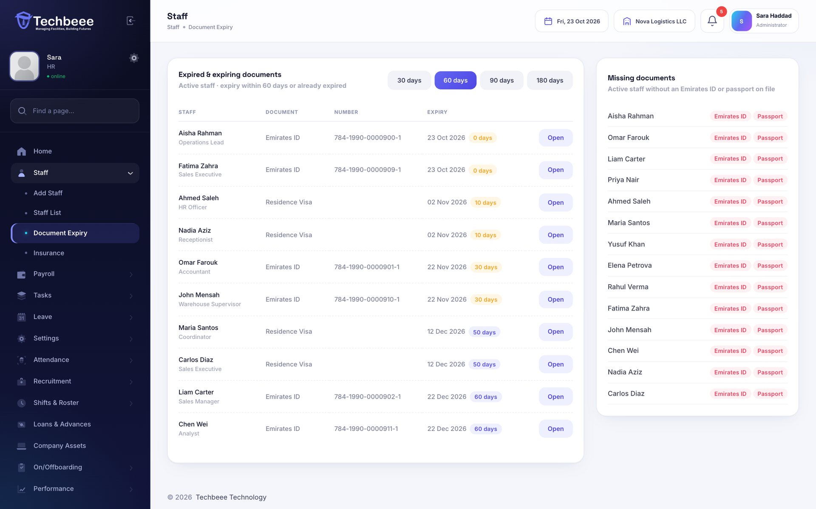
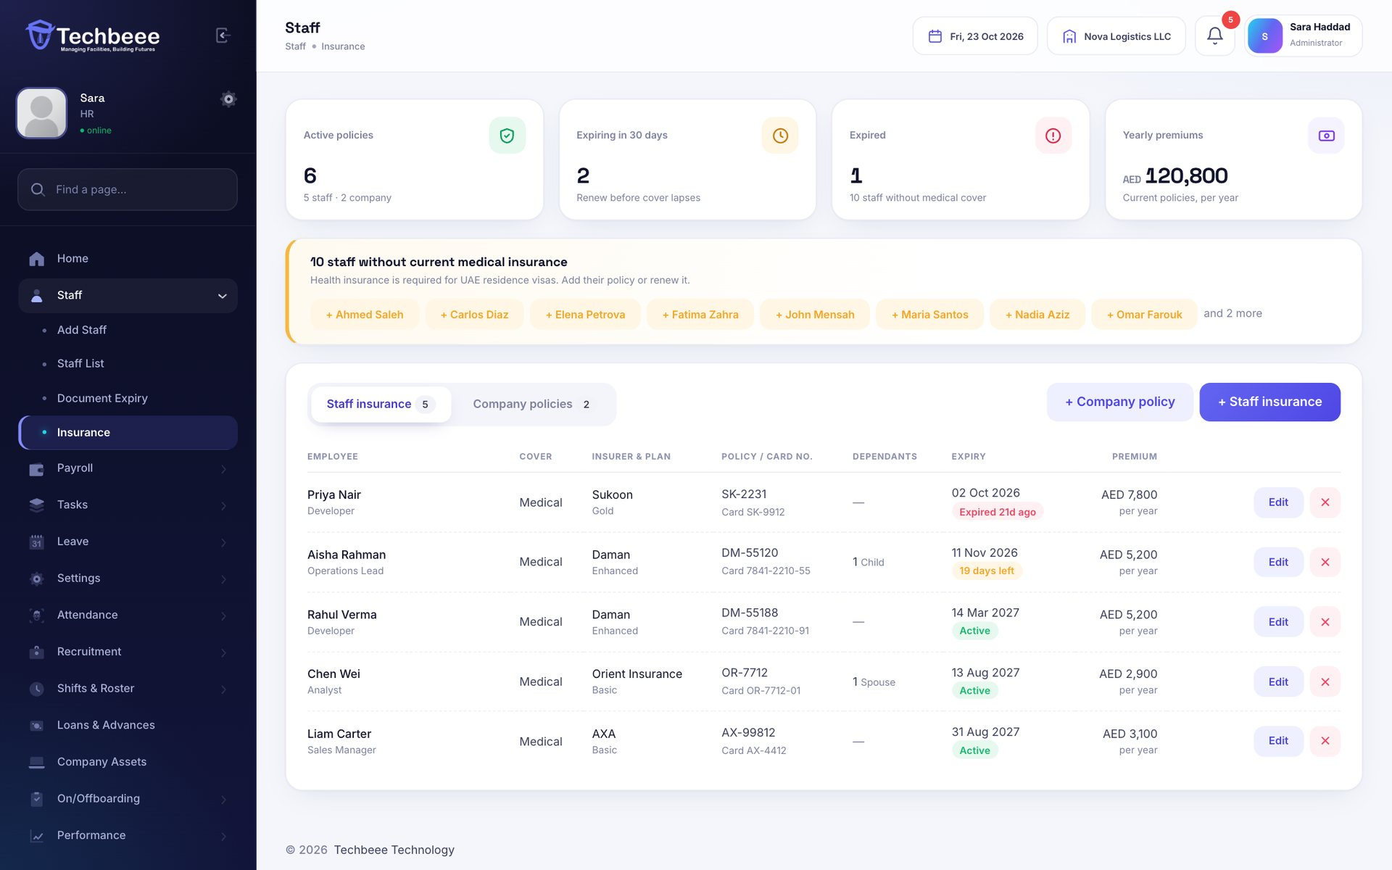
Documents and insurance with expiry alerts
DOCUMENTS & INSURANCE
Emirates ID, visa, passport, contracts and medical insurance — with reminders before anything runs out.
Staff upload documents; HR verifies them
Medical cards with dependants and premiums
Company policies: group medical, vehicles, property
Email and bell reminders 30 days before expiry
Notes:
Files are stored privately and only the employee and their company's admins can open them.

Slide 14
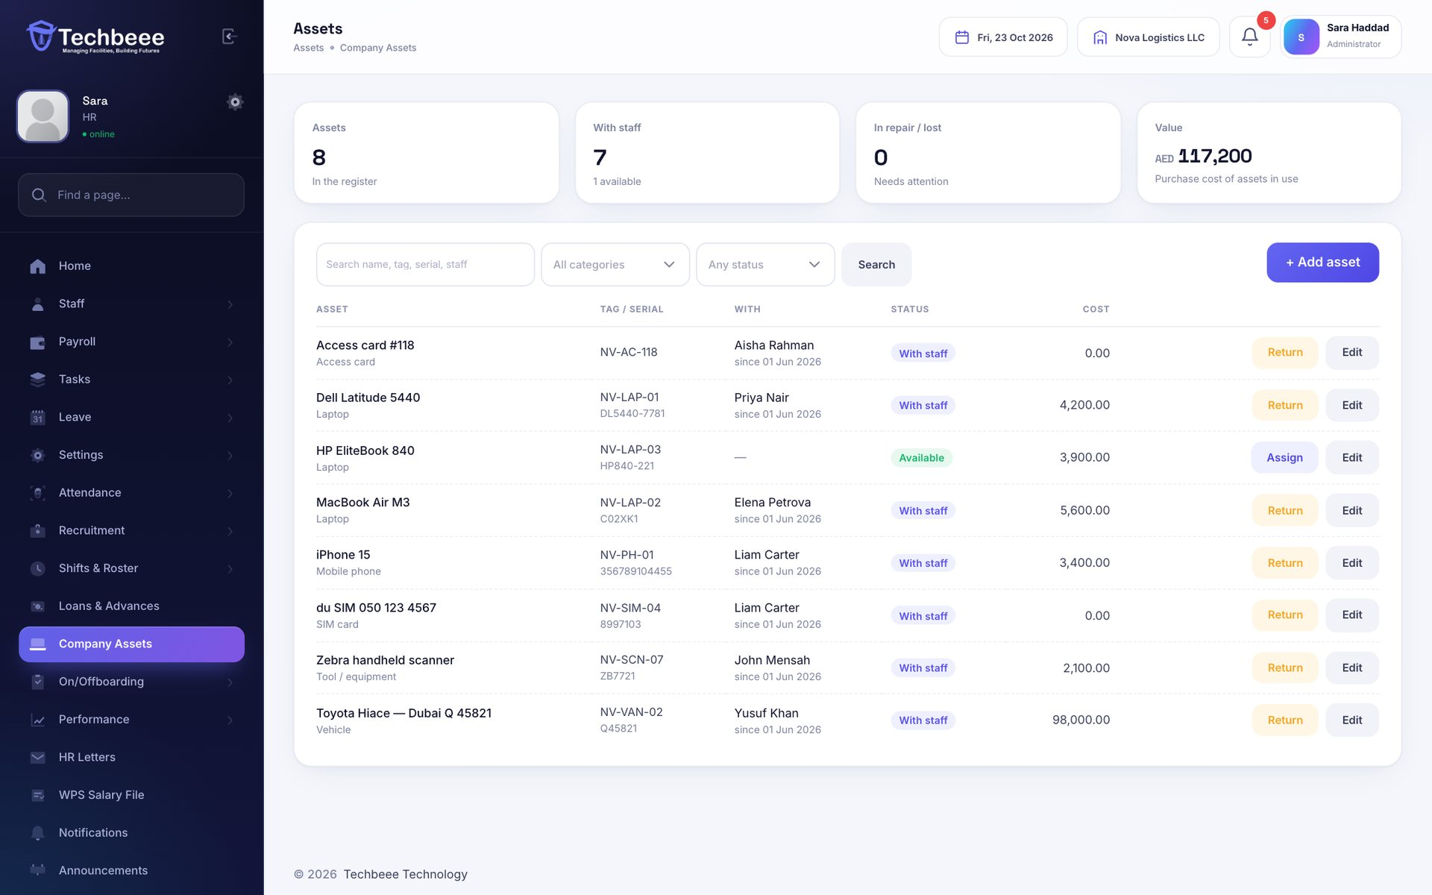
Company assets and who has them
COMPANY ASSETS
Laptops, phones, SIM cards, vehicles and tools — issued to staff and collected back when they leave.
Tag, serial, model, purchase date and cost
Hand over and return with the condition
Full history of who had each asset
Unreturned assets shown in offboarding
Notes:
Employees see the assets issued to them in the app.

Slide 15
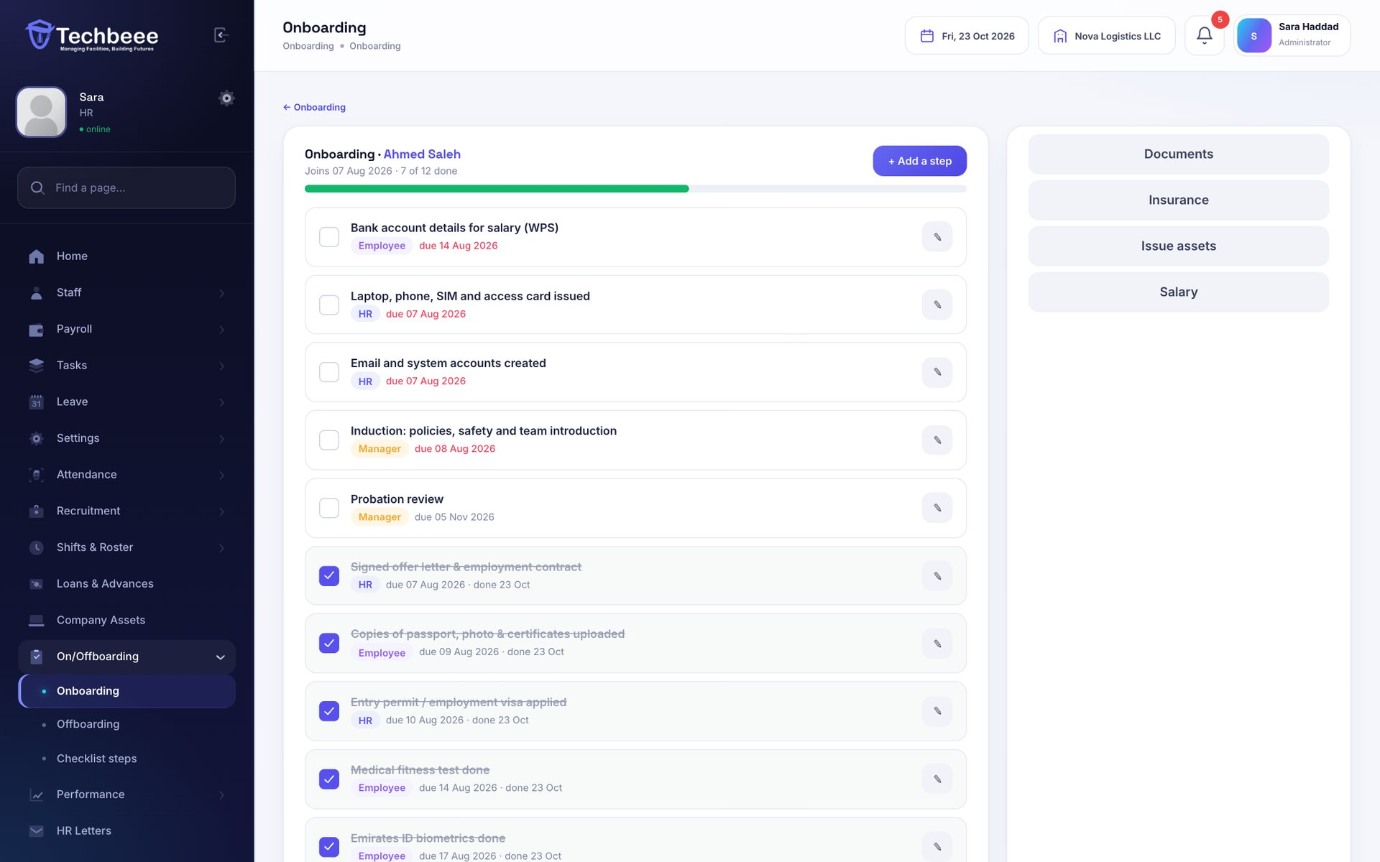
Onboarding and offboarding checklists
ON/OFFBOARDING
Every step for a joiner or a leaver — with an owner and a due date — so nothing is missed.
UAE starter steps: visa, medical, Emirates ID, MOHRE
Owners: HR, the employee or their manager
Starts automatically for new staff and leavers
Employees tick their own steps in the app
Notes:
Each company can edit its own list of steps.

Slide 16
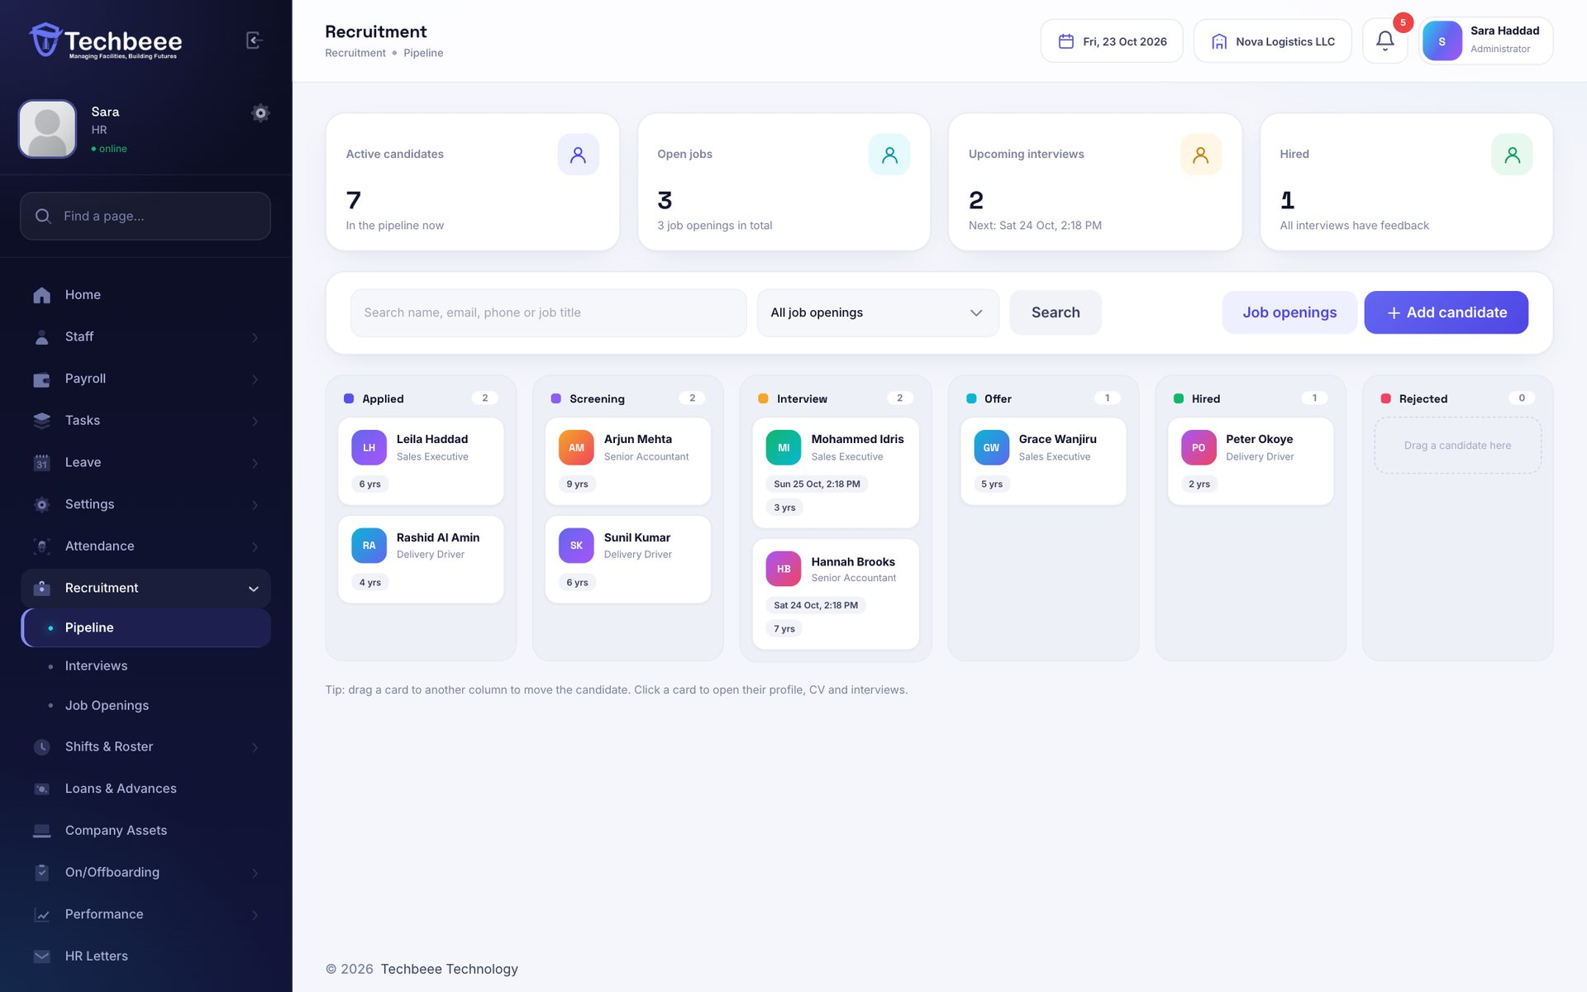
From job opening to hired
RECRUITMENT
Post openings, add candidates with their CV and move them through a drag-and-drop pipeline.
Applied → Screening → Interview → Offer → Hired
Interviews in person, by phone or video
Scorecards for skills, communication and fit
Create the staff account from the hire
Notes:
Recruitment can be delegated to an HR assistant role.

Slide 17
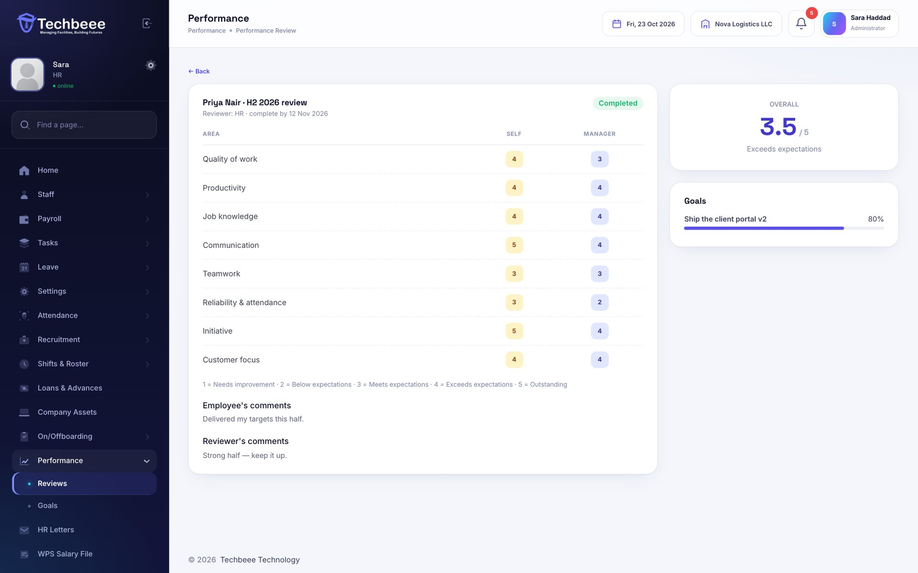
Performance reviews and goals
PERFORMANCE
Employees rate themselves, then their department head or HR completes the review with an overall score.
Eight areas rated 1 to 5
Self-review first, manager review second
Goals with targets and progress
Scores on the profile and in the app
Notes:
Review cycles can cover the whole company or one department.

Slide 18
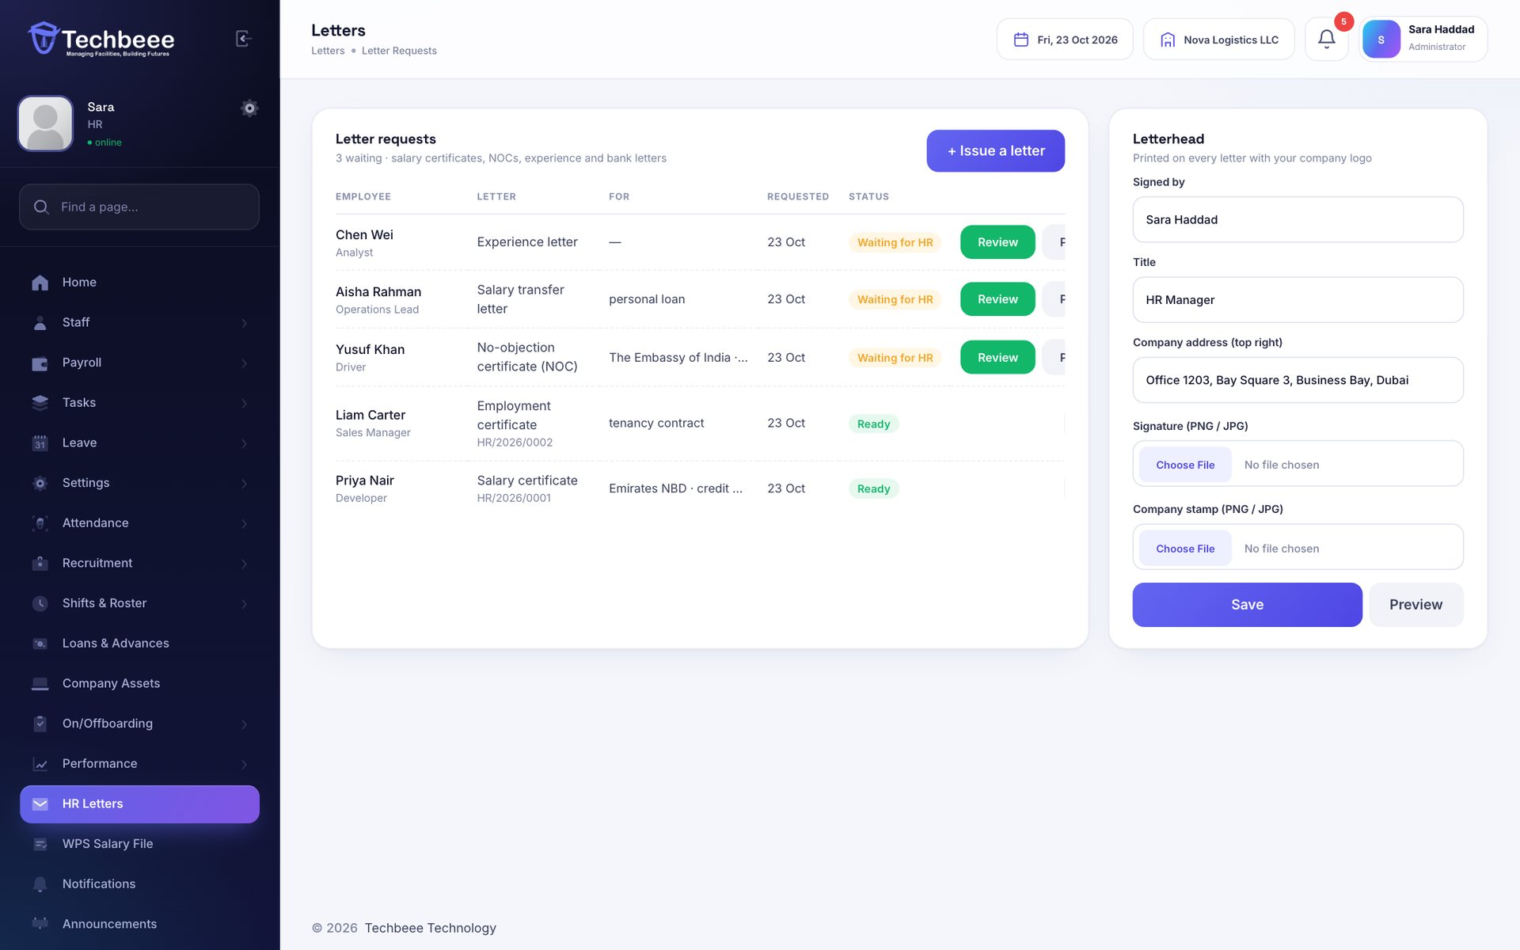
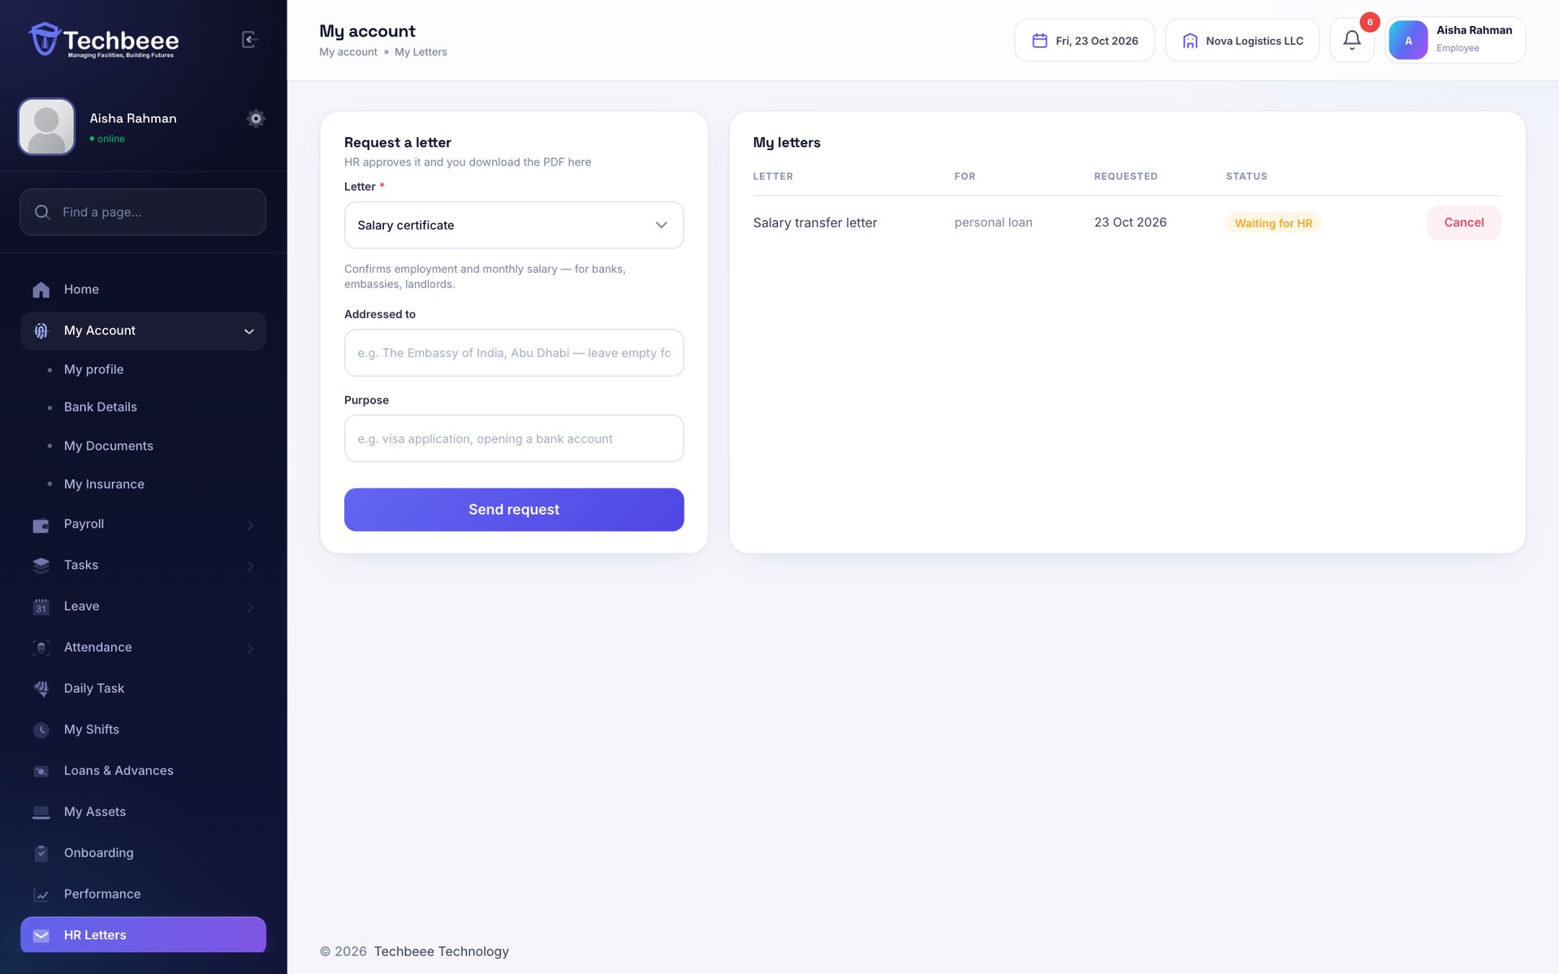
HR letters in a click
HR LETTERS
Staff request a letter; HR approves and a PDF on your letterhead is ready to download.
Salary certificate and salary transfer letter
NOC for travel or visa, experience letter
Logo, reference number, signature and stamp
Employees download it from the app
Notes:
HR can also issue a letter directly without a request.

Slide 19
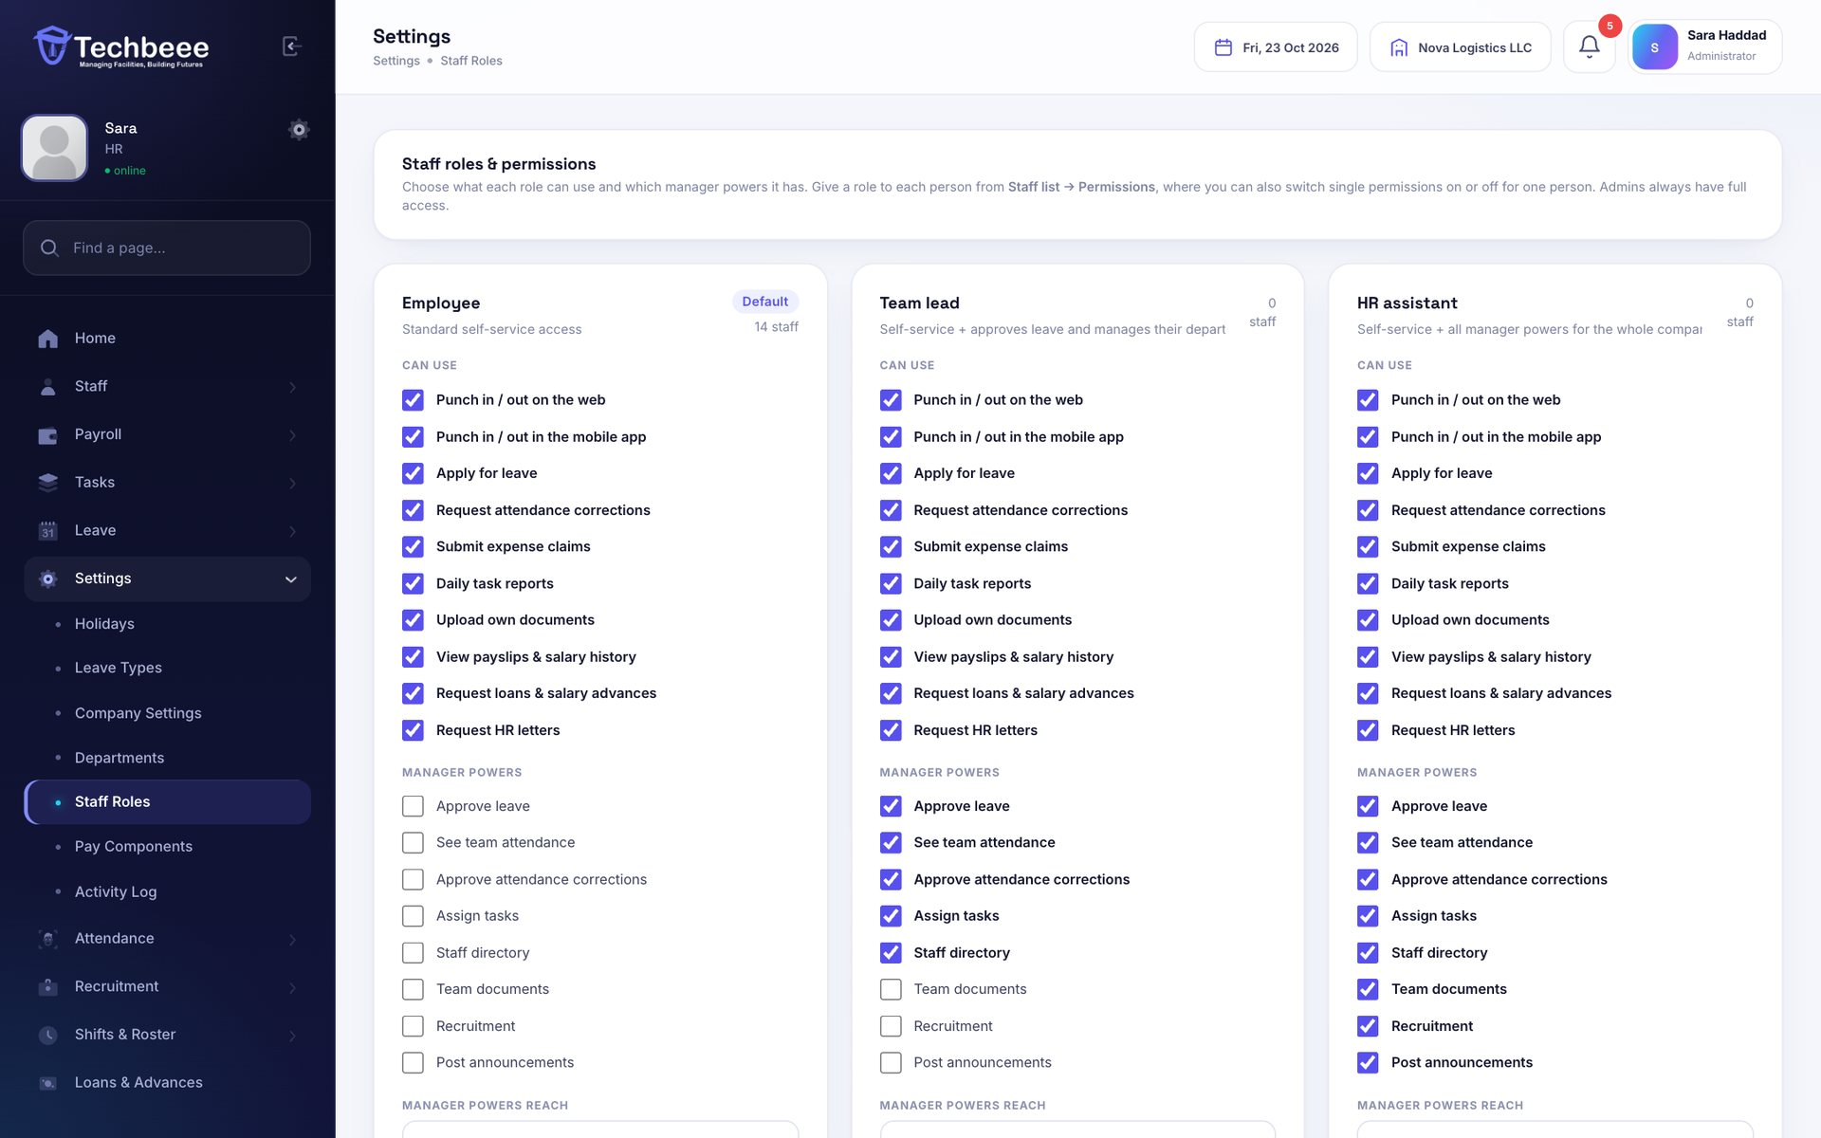
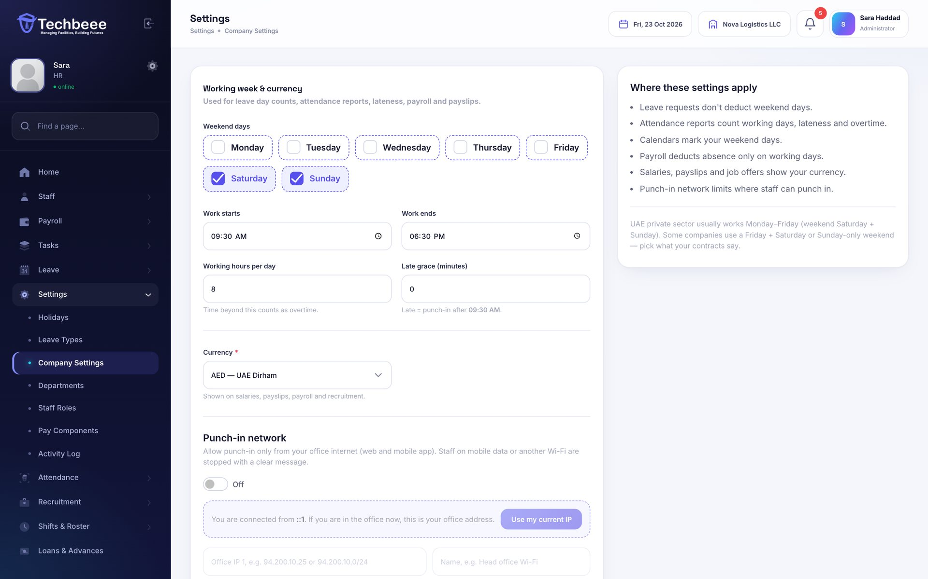
Roles, permissions and settings
CONTROL
Decide who can do what, and set the company up your way.
Employee, Team lead and HR assistant roles
Manager powers for a department or the company
Weekend, hours, late grace and currency
Activity log of every action
Notes:
Team leads can approve leave for their department without full admin access.

Slide 20
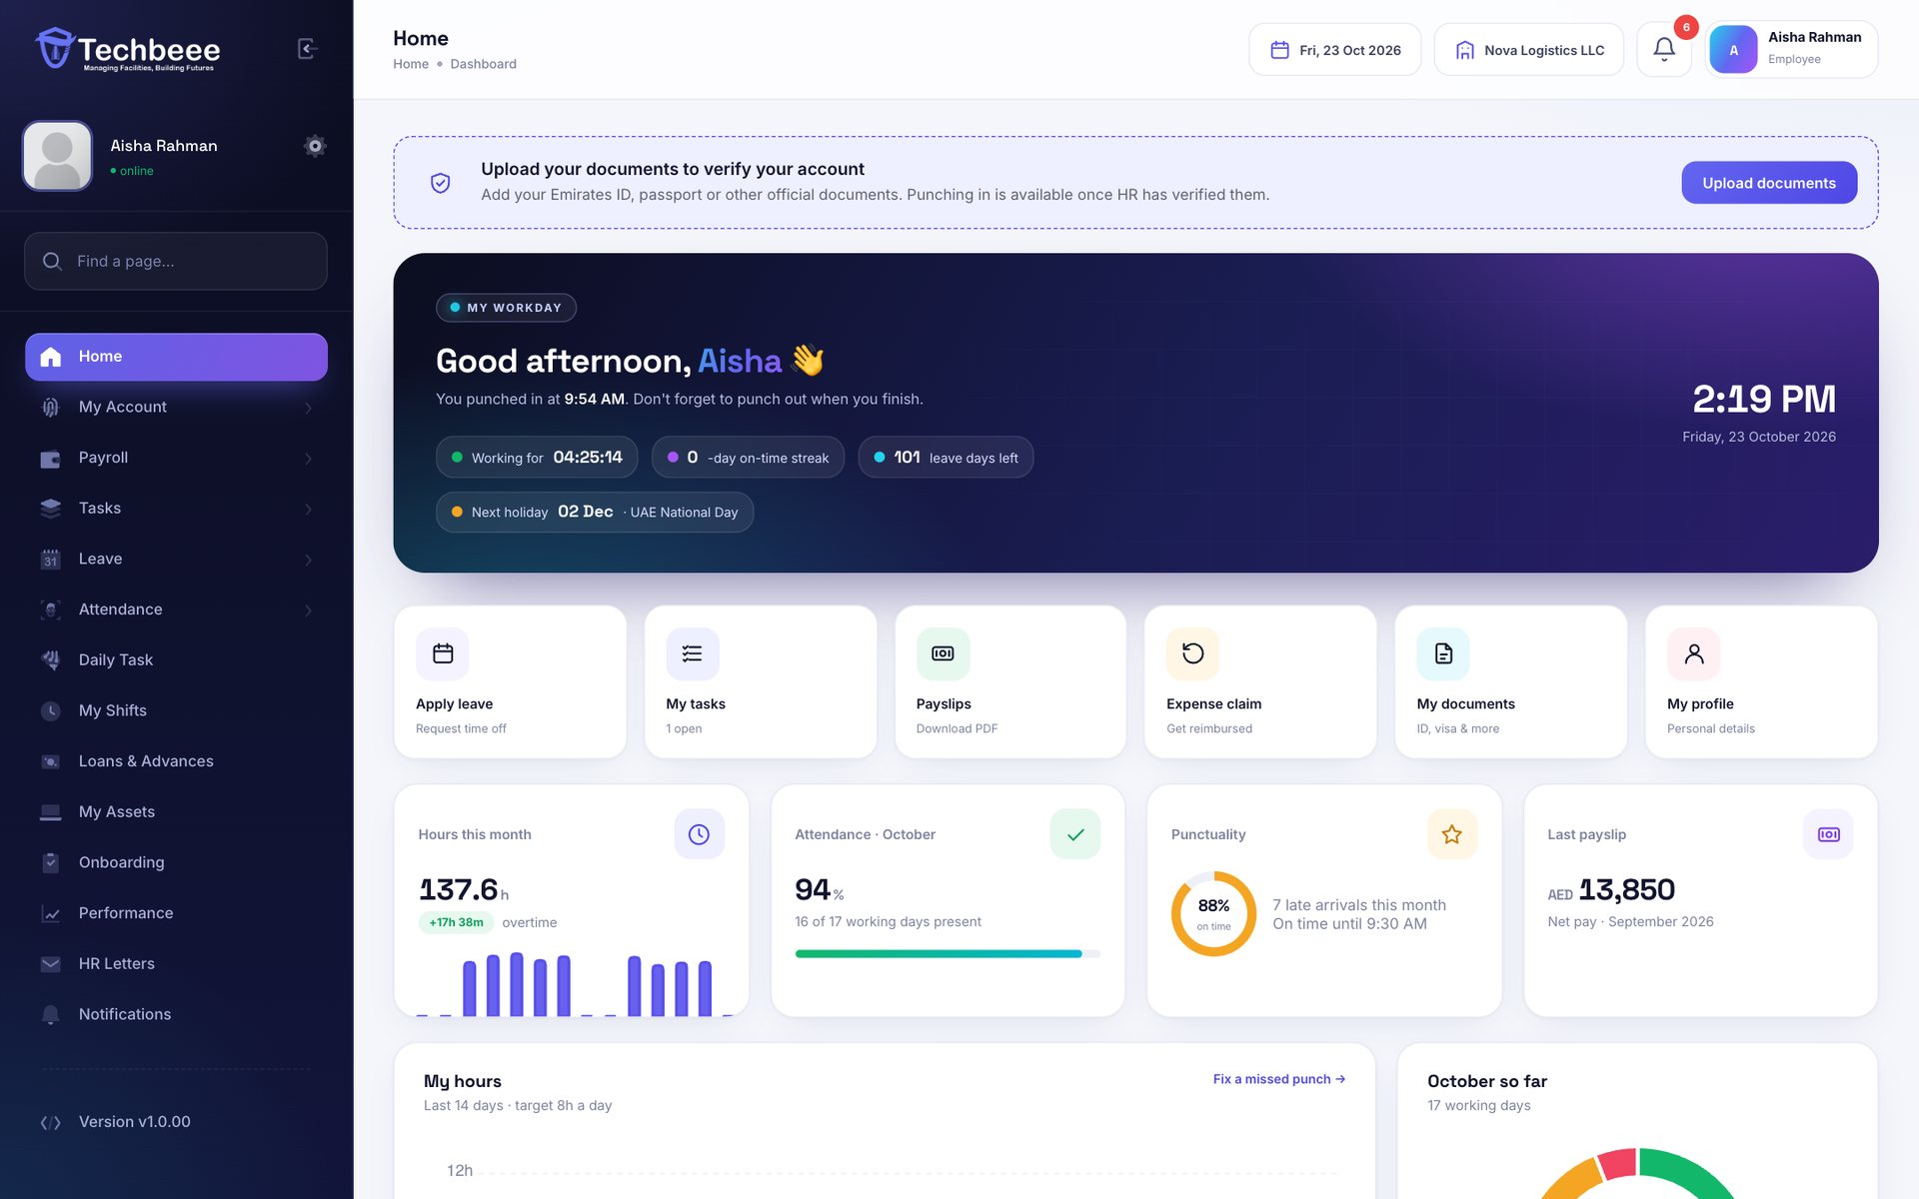
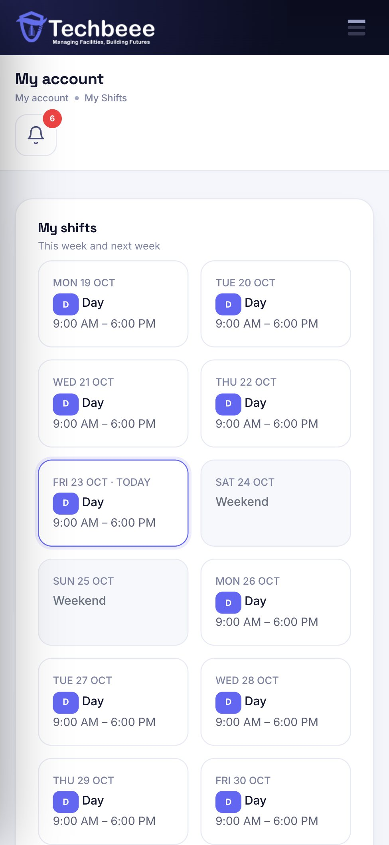
HR in every employee’s pocket
SELF-SERVICE
A personal dashboard on the web and in the iOS and Android app.
Punch in and out; see this month’s attendance
Leave, expense claims, loans and letters
Payslips, documents and insurance card
Shifts, tasks, onboarding steps and reviews
Notes:
Everything an employee does shows up for HR straight away.

Slide 21
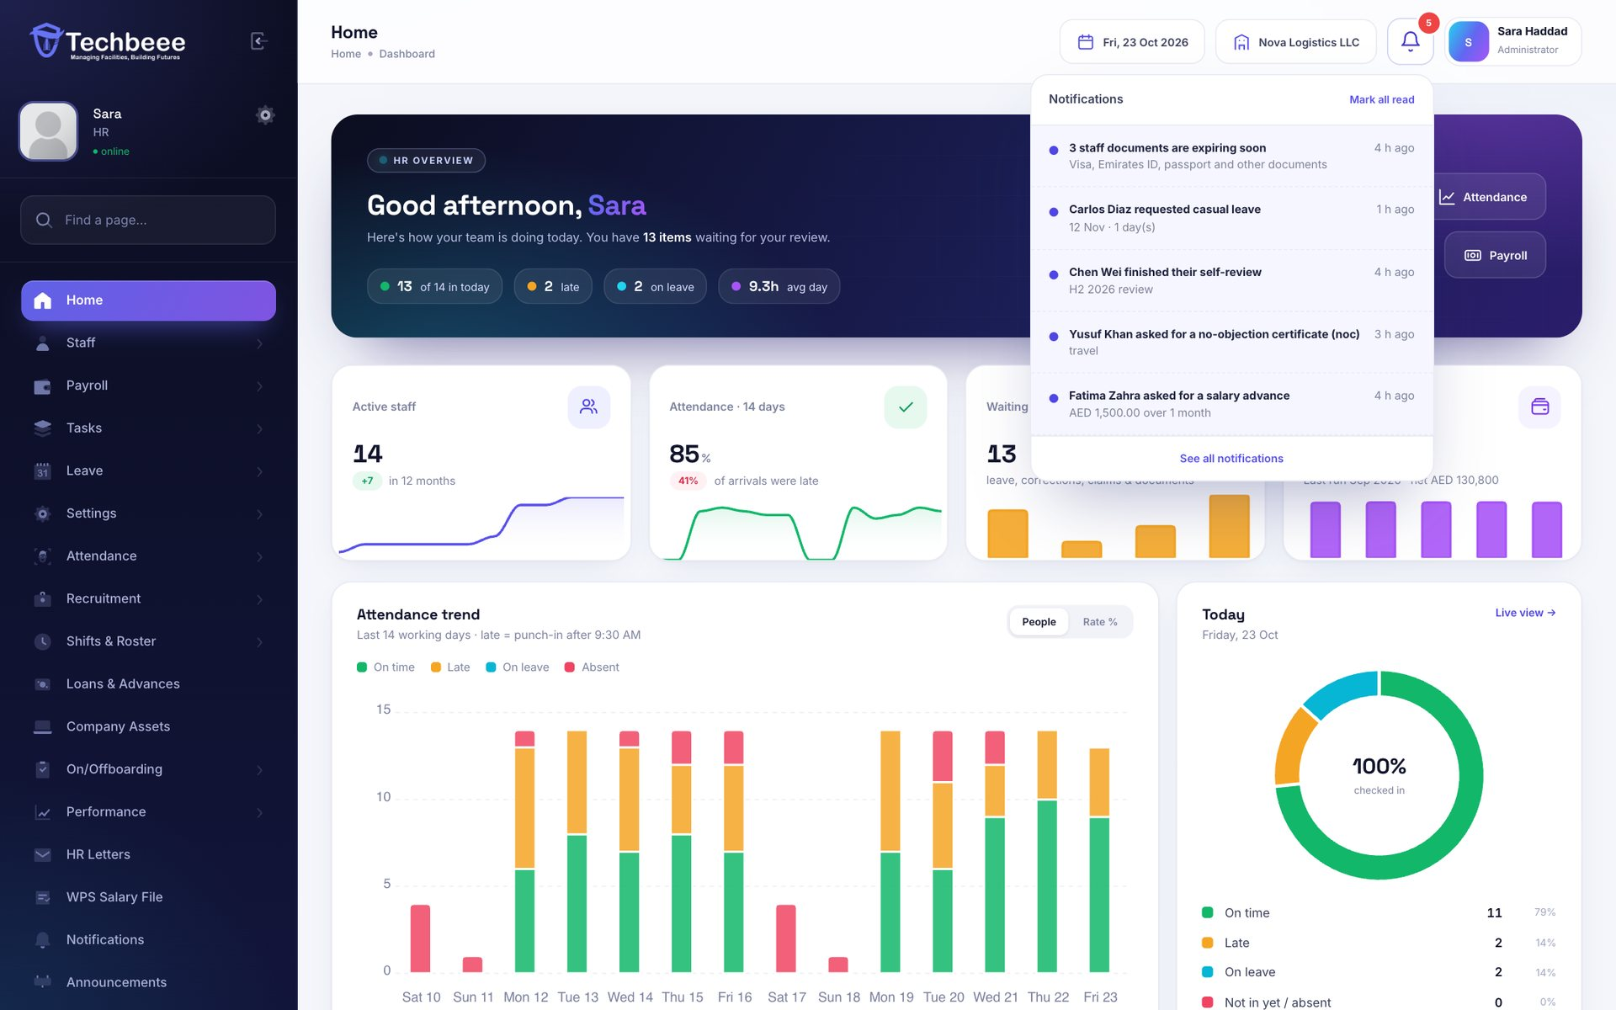
Nothing waits unnoticed
NOTIFICATIONS
A bell for HR and for every employee — requests, decisions, payslips and expiries as they happen.
Leave, corrections, claims and documents
Loans, letters, reviews and payslips
Expiring documents and insurance renewals
Also in the mobile app
Notes:
HR is notified of new requests; employees are notified of decisions.

Slide 22






Secure by design
Encrypted passwords and sessions
Every company is separate
Full activity log
bcrypt passwords, HTTPS-only cookies, protection against forged requests
Admins only ever see their own company’s staff and data
Approvals, payroll, settings and sign-ins — searchable and exportable
Office-network punch-in
Private document storage
Roles and permissions
Optional rule to accept punch-in only from office IP addresses
Files open only for the employee and their company’s admins
Give each person only the powers they need
Notes:
Security basics are built in, and each company's data is isolated from every other company.

Slide 23
Start free in three steps
1
2
3
Register your company
Add up to 10 staff
Activate full access
A short form — your workspace is ready in about a minute. No payment details.
Try attendance, leave, payroll and every other feature for 30 days.
Press “Request activation” — we switch on unlimited staff and your data stays.
Free for 30 days · up to 10 staff · no card needed
hrms.techbeesoft.com/free-trial
Questions? Call or WhatsApp
+971 56 388 6329
Notes:
The trial includes every module. After 30 days, the company asks for activation and keeps all its data.

Slide 24





Let’s get your team on Techbeee HRMS
Phone & WhatsApp
+971 56 388 6329
Email
support@techbeesoft.com
Website
techbeesoft.com
Techbeee Technology — software solutions company in Dubai, UAE.
Start a free trial
hrms.techbeesoft.com/free-trial
Office
Hor Al Anz, Dubai, United Arab Emirates · P.O. Box 231525
Dubai DET E-Trader License No. 1514620
Notes:
Thank you. For a demo or the free trial, call or WhatsApp +971 56 388 6329 or email support@techbeesoft.com.

